Slide 1
Network Administrator
Notes:
Abstract
This 24-slide presentation, published January 2003, details the Microsoft IT group preventative approach to managing computer vulnerabilities. Designed to reduce the occurrences and severity of attacks, Microsoft IT’s security methodology includes the development of processes to reduce open ports and vulnerable systems and services, manage user permissions, regularly assess risks, and regularly monitor compliance with security guidelines.
Executive Summary
Security threats to computer networks often come from attackers who take advantage of security flaws, such as well-known configuration errors and published product vulnerabilities. Just like any enterprise, Microsoft is the target of computer attacks. These attacks are often discussed in newsgroups or chat rooms, and the attack tools are frequently published on the Internet.
At one time, Microsoft used a reactive approach: If an exploit occurred, resources were deployed and narrowly focused on that exploit only. The process involved deploying and testing a patch on a single server and then distributing the patch to other servers at risk. This process was too time consuming—and involved too much risk to resources – to address a vulnerability effectively.
Accordingly, the Information Security Organization (InfoSec), within the Microsoft IT group, developed a preventative approach to managing computer vulnerabilities. Designed to reduce the occurrences and severity of attacks, The InfoSec security methodology includes reducing open ports and vulnerable systems and services, managing user permissions, regularly assessing risks, and regularly monitoring compliance with security guidelines.
InfoSec also developed a consistent process for responding to incidents and recovering from disasters that do occur. The primary objectives of this process are to establish a clear command and control center, to rapidly mitigate exposure, to maximize cooperation, and to efficiently coordinate response activities. All of these efforts are designed to eliminate network exposure and restore confidence in all systems as quickly as possible. The same overall response plan process is used for both computer incidents and other incidents, such as natural disasters. The focus of this paper is computer incident response. Although the approaches to all responses are similar, the actual steps taken to address specific computer incidents can be different, depending on the nature of the incident.

Slide 2
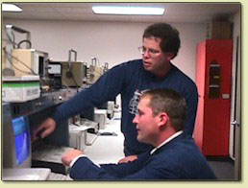

The role of an IT (Information Technology) Professional
Networks are no longer a luxury, but a requirement to keep the organization running.

Slide 3
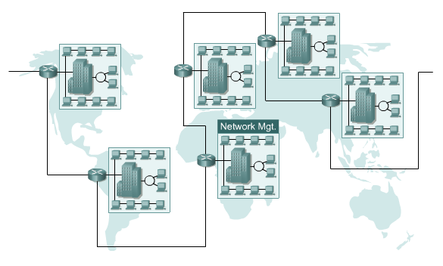
Evolution of Networking

Slide 4

















































































CISCO Router
Using acl
,
block malware
from outside
INTERNET
All Server in DMZ
ROUTER
-
Manage using SSH
,
GTW
Secure Webmin
PROXY
(
Squid
)
FIREWALL
-
IDS
All access to Internet
FIREWALL
Linux bridge
,
iptables
DMZ
must through Proxy
shorewall
,
snort
,
Managable Switchs
portsentry
,
acidlab
Block unwanted user from port
,
manage from WEB
SQL Database
(
MySQL
)
Access only from
MULTILAYER
localhost
(
127
.
0
.
0
.
1
)
SWITCH
L
3
Switch
Block malware on
physical port from inside
network
LECTURER
DOMAIN
E
-
MAIL
WWW
PROXY
NOC
,
EMPLOYEE
Traffic Monitoring
CACTI
Http
://
noc
.
eepis
-
its
.
edu
E
-
Mail server
(
HTTPS
,
SPAM
EEPISHOTSPOT
Spamassassin
)
,
Virus
Access from wifi
,
signal
Scanner
(
ClamAV
)
only in EEPIS campus
Authentication from
Proxy
FILESERVER
EIS
STUDENTS
Internal Server
EEPIS
-
INFORMATION SYSTEM
(
EIS http
://
eis
.
eepis
-
its
.
edu
)
EEPISHOTSPOT
Http
://
fileserver
.
eepis
-
its
.
edu
Adopted from http://lecturer.eepis-its.edu/~dhoto/...

Slide 5
Network Services
Telnet/FTP
DHCP Service
DNS Service
Web Service
Mail Service
Dialin Service
File Sharing/Samba
Proxy
Traffic Monitoring /MRTG/CACTI
Security Service

Slide 6
Who are Responsible
Computer Technician
  Responsible for setting up and maintaining the users’ computers.
  Putting the computers together.
  Adding new hardware: RAM, CD-ROM drive, Monitor, etc.
  Installing software
  Setting up accounts, email, and access to servers
  Troubleshooting
Network Technician
  Connecting the computers to the network.
  Setting up any wireless network access.
  Configure the routers and switches.
    Basic configurations
    Security
    Traffic flow
System Administrator
  Maintaining the “file servers”, the computers that store the software and data used by everyone.
  Setting up usernames and passwords for controlling access to the network.
  Setting up and maintaining the servers that control Email.
  Keep the computers secure from viruses and hackers.

Slide 7
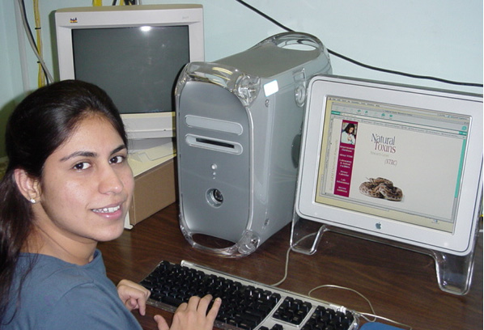
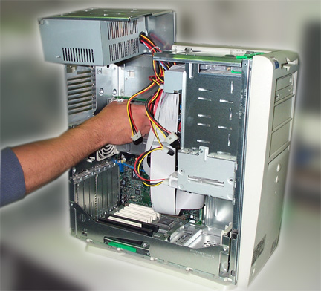
Computer Technician
“Desktop” support
  Responsible for setting up and maintaining the users’ computers.
  Putting the computers together.
  Adding new hardware: RAM, CD-ROM drive, Monitor, etc.
  Installing software
  Setting up accounts, email, and access to servers
  Troubleshooting
  Helping users

Slide 8
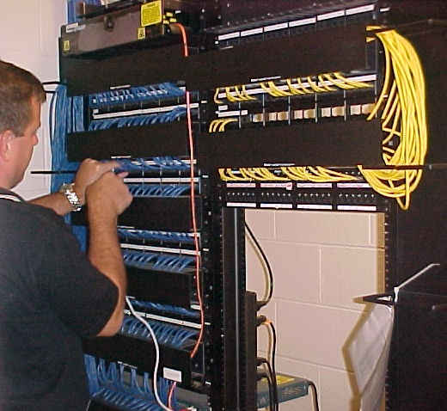

Network Technician
Connecting the computers to the network.
Install, manage, troubleshoot network infrastructure:
  Routers, Switches, Cables, Wireless Access Points
Issues:
  Security
  Quality of Service
  Video On Demand
  IP Telephony or Voice over IP
Setting up any wireless network access.
Configure the routers and switches.
  Basic configurations
  Security
  Traffic flow

Slide 9
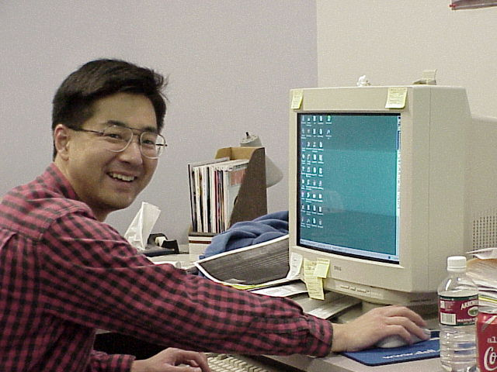
System Administrator
Maintaining the “file servers”, the computers that store the software and data used by everyone.
Setting up usernames and passwords for controlling access to the network.
Setting up and maintaining the servers that control Email.
Keep the computers secure from viruses and hackers.

Slide 10

Sys Admin Handle
User
How many users are there?
The level of the user's expertise.
What are the users trying to do?
Are they responsible or irresponsible?
Who do the users know?
Hardware Software
How many, how big and how complex?
Is there a network?
Are the computers heterogenous or homogenous?
Notes:
Solution Overview
Security threats to computer networks often come from attackers who take advantage of security flaws, such as well-known configuration errors and published product vulnerabilities. Just like any enterprise, Microsoft is the target of computer attacks. These attacks are often discussed in newsgroups or chat rooms, and the attack tools are frequently published on the Internet.
Solution
Microsoft IT developed a consistent process for responding to incidents and recovering from disasters that do occur. The primary objectives of this process are to establish a clear command and control center, to rapidly mitigate exposure, to maximize cooperation, and to efficiently coordinate response activities. All of these efforts are designed to eliminate network exposure and restore confidence in all systems as quickly as possible.
Benefits
Microsoft IT’s detailed, well-rehearsed, and flexible incident response plan ensures that any exploit that occurs can be handled in an orderly, effective manner that minimizes the impact to systems.

Slide 11
Sys Admin Handle
What System Administrator Do ?
ensuring that the computing system runs correctly and as efficiently as possible, and
ensuring that all users can and do use the computing system to carry out their required work in the easiest and most efficient manner
Conflict
Management will wish to restrict the amount of money spent on computer systems.
The users on the other hand will always want more disk space and faster CPUs.
The System Administrator must attempt to balance these two conflicting aims
Notes:
Solution Overview
Security threats to computer networks often come from attackers who take advantage of security flaws, such as well-known configuration errors and published product vulnerabilities. Just like any enterprise, Microsoft is the target of computer attacks. These attacks are often discussed in newsgroups or chat rooms, and the attack tools are frequently published on the Internet.
Solution
Microsoft IT developed a consistent process for responding to incidents and recovering from disasters that do occur. The primary objectives of this process are to establish a clear command and control center, to rapidly mitigate exposure, to maximize cooperation, and to efficiently coordinate response activities. All of these efforts are designed to eliminate network exposure and restore confidence in all systems as quickly as possible.
Benefits
Microsoft IT’s detailed, well-rehearsed, and flexible incident response plan ensures that any exploit that occurs can be handled in an orderly, effective manner that minimizes the impact to systems.

Slide 12
Network Administrator Activity
Fault Management
device management
Configuration Management
performance management
history management
Accounting
security
Management Scope
Maintenance and upgrade
Remote access

Slide 13
What Systems Administrators need to know
programming,
Systems Administrators have to be able to program. They might have to write scripts that automate regular tasks or a Visual Basic program to help users perform certain tasks.
hardware maintenance and installation,
This may range from installing new hardware to cleaning old hardware so that it continues to work.
documentation and testing,
Human Computer Interface,
networks and computer communication,
user education,
diplomacy,
legal issues and contracts,
detective work,
management and policy setting, and
public relations.
Notes:
Preventing Incidents
A key to preventing security incidents is to eliminate as many vulnerabilities as possible. The sections that follow describe actions that are instrumental in preventing incidents.
Scanning
Because most attackers use multiple tools to target an enterprise, the Monitoring and Compliance group at Microsoft uses a variety of automated scanning tools to identify and remediate vulnerabilities. Scanning is distributed, not centralized. That is, multiple scans run across the network simultaneously. Dedicated workstations scan thousands of hosts per week. Using dedicated workstations allows efficient CPU utilization.
Information is reported by means of a SQL Server 2000 database to aid in risk assessment, analysis, and reporting. However, technology alone does not create a solution; both processes and people must be in place to accurately identify and act upon vulnerabilities. Thus, only a restricted group of personnel manages the data.
Auditing
Using tools similar to those applied in the scanning process, the Monitoring and Compliance group conducts audits to ensure that corrective action is taken when the level of noncompliance surpasses the set tolerance level for vulnerabilities on that part of the network. A priority is assigned to the non-complying items and a service request is opened to correct the problem. Verifying that a problem has been fixed is a process of scanning, reviewing the scan report, and then entering a remediation loop that fixes the problem or creates a notification of the problem and then scans again. The process continues repeatedly until the problem is resolved. The Monitoring and Compliance group plans for a certain number of audits every year, in addition to benchmark audits conducted every few months.
Detecting Intrusions
The Monitoring and Compliance group uses a combination of Microsoft tools and third-party tools to detect intrusions inside the network and on the perimeter. The group reviews Internet Security and Acceleration Server (ISA) logs and conducts remote access audits to ensure that remote access accounts are being used only by the owners of those accounts. Thorough intrusion detection involves some potential problems. Testing for a correlation of events within the network traffic of a large organization can produce false positives (that is, independent events can appear to correlate by coincidence) and creates additional analysis work for personnel. However, the benefits generally outweigh the potential problems.
Establishing Defense in Depth: An Example
Attackers look for holes that they can use to gain access to networks. A multilayered defense strategy, called defense in depth, stops more attacks than a single point of protection.
Securing Clients for Remote Users
A network administrator can ensure that a user is following guidelines by scanning the user’s system and denying remote access if the user does not have the correct patches, programs, and security settings.

Slide 14
Need another Skill
Communicating with Users
Communicating with management

Slide 15
Reference
http://Cisco.netacad.net
http://www.cabrillo.edu
An Introduction to Linux Systems Administration by David Jones & Bruce Jamieson

